Slide 1

Recommendation System Using Machine Learning Techniques
Aditya Rana
Karthikey Sharma
Under The guidance of
MR. Dhananjay kumar

Slide 2
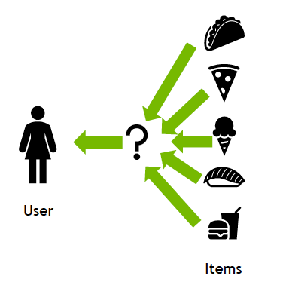
Introduction
Recommender systems are a way of suggesting like or similar items and ideas to a user's specific way of thinking.

Slide 3
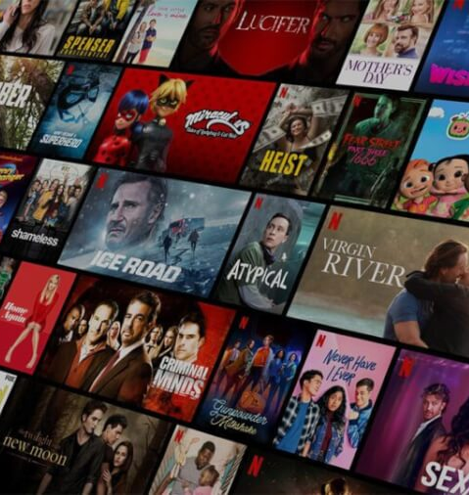
Movie Recommendation System
A movie recommendation system is a type of software that suggests movies to users based on their preferences, viewing history, and other factors.

Slide 4
OBJECTIVE
Personalization:
Increased Engagement:
Increased Revenue:
Reduced Information Overload:
Improved Customer Satisfaction:

Slide 5



Significant industrial & research interest in recommendation systems -
2 out of 3 watched hours come from recommendations
35% of all sales are generated by recommendations
Increases its watch times by 50% per year

Slide 6
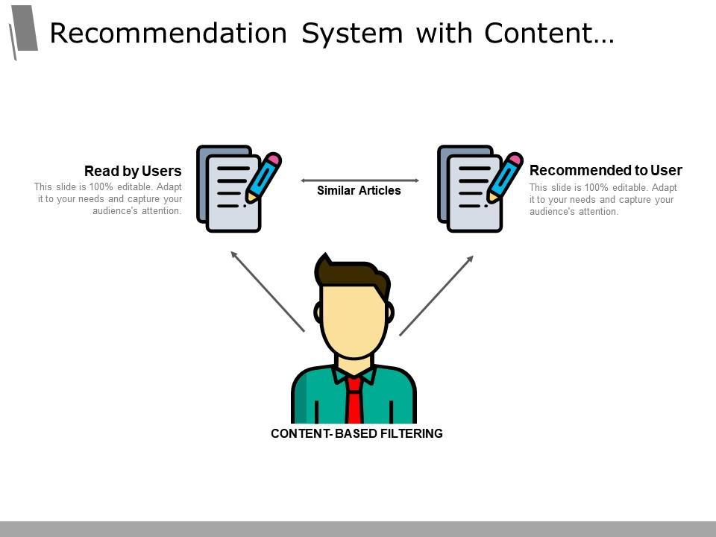
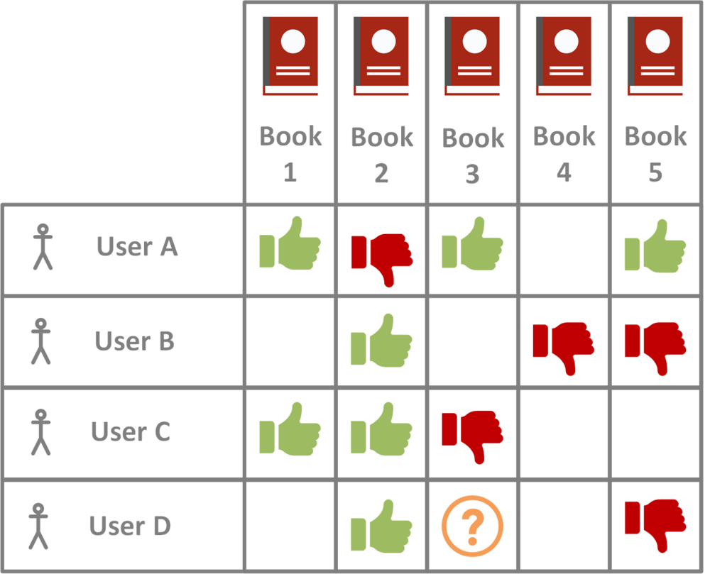
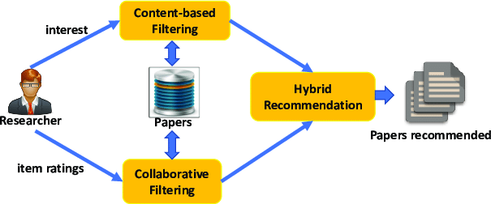
Types Of Recommendation System:
Content Based Recommendation
Collaborative Filtering
Hybrid

Slide 7

Methodology:

Slide 8

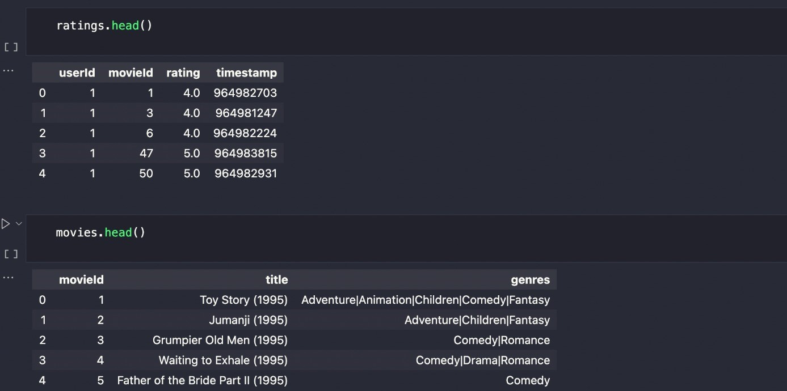
Dataset:

Slide 9

Data Pre-processing:
We merge 2 datasets based on "movieId"
Dropping unnecessary columns .

Slide 10
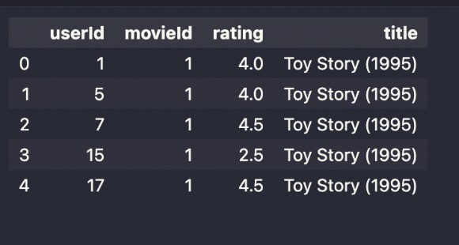
After Merging :

Slide 11

The User Item Rating Matrix is a two-dimensional matrix that represents the ratings that users give to different items.
User Item Rating Matrix

Slide 12
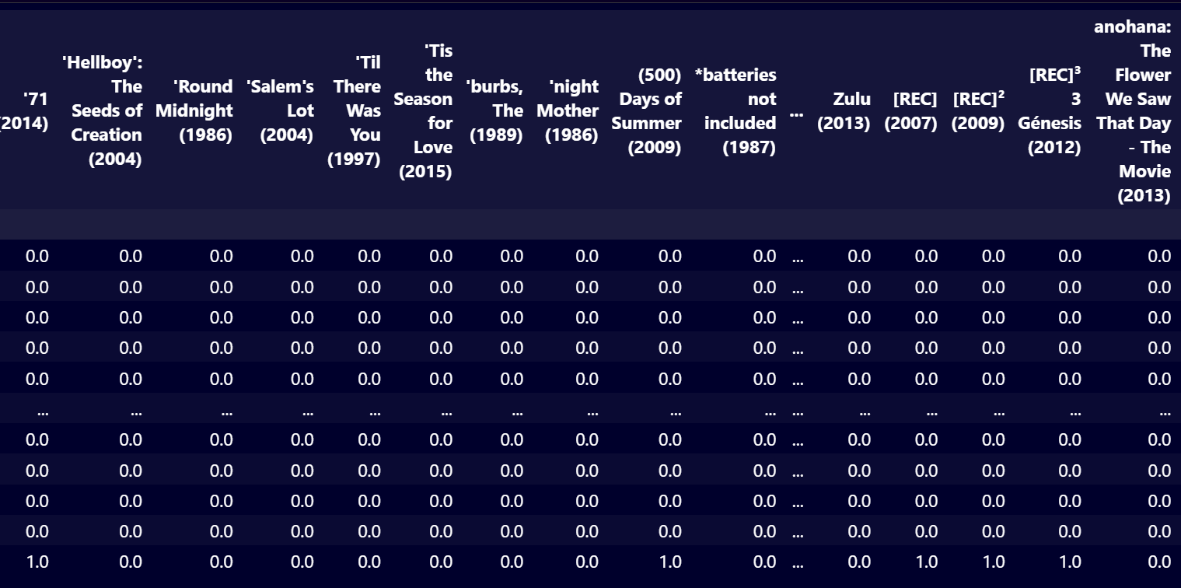
User-Item Rating Matrix:

Slide 13
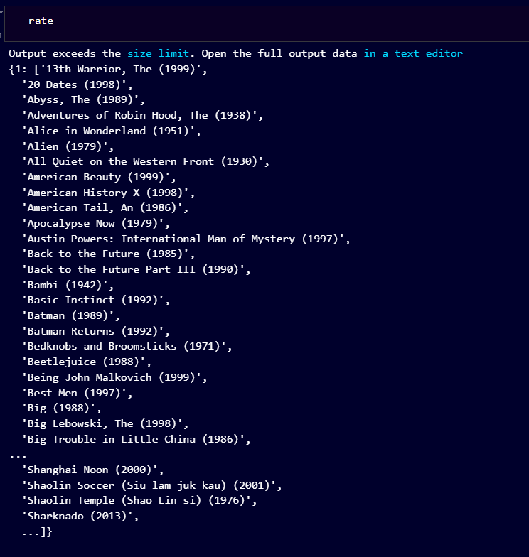
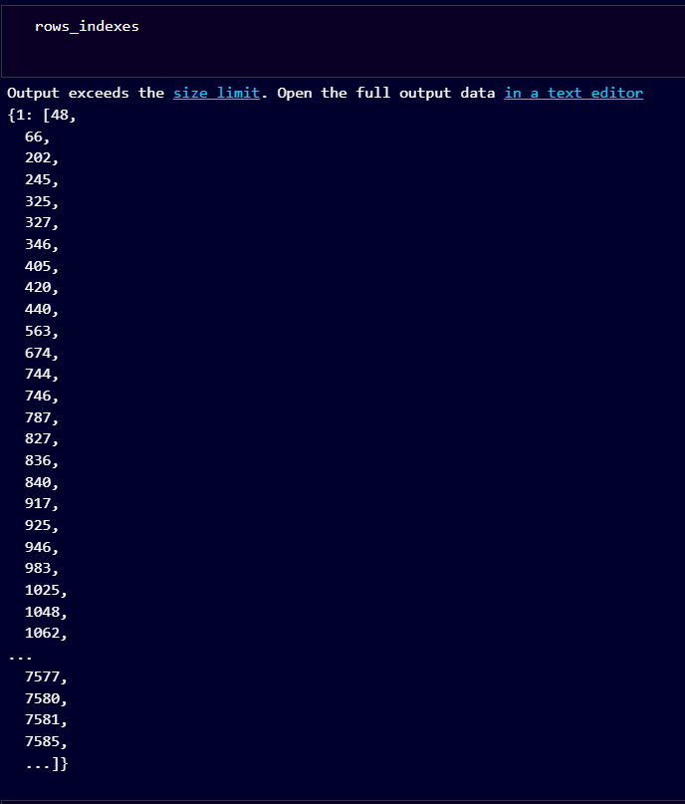
'Rate' Dictionary:
'Rows_indexes' Dictionary:

Slide 14
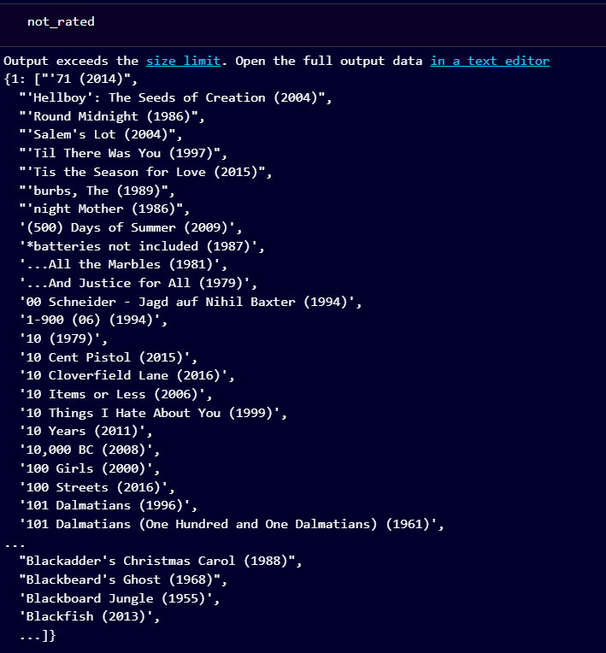
'not_rated' DICTIONARY

Slide 15
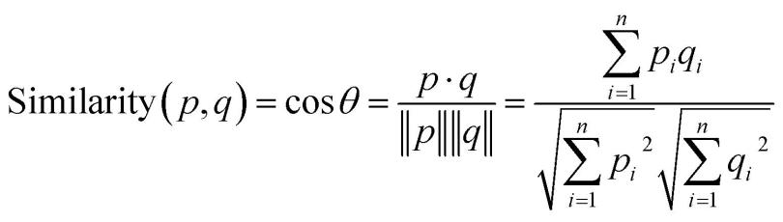
Nearest Neighbour Recommender:
We will be using item-item collaborative filtering with nearest neighbor and cosine similarity to implement our movie recommendation system.

Slide 16
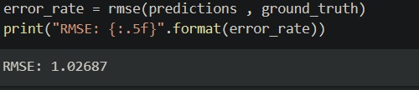
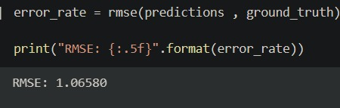
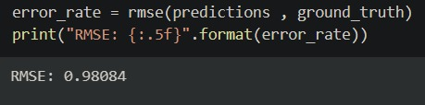
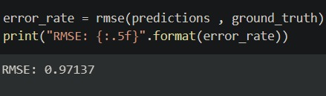
EXPERIMENTS
Manhattan Distance
Euclidean Distance
Minkowski
Chebyschev
Cosine

Slide 17
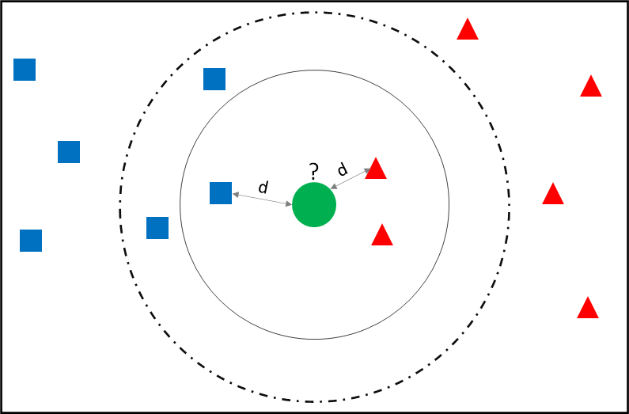
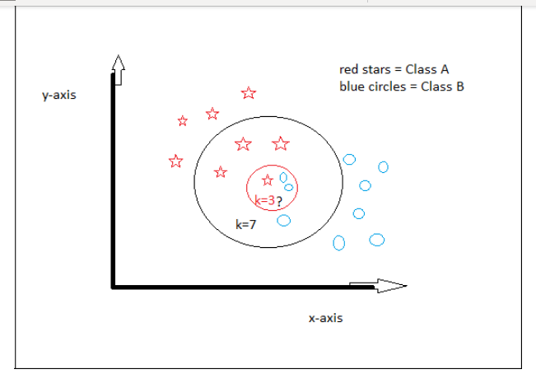
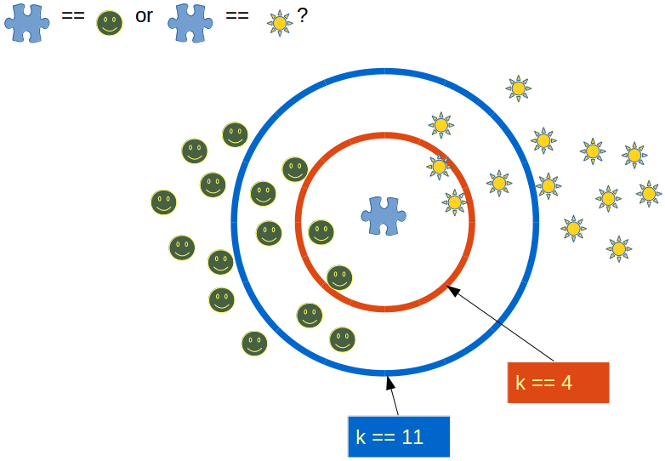
Calculating Scores
Transposed pivot table
Fit function
item_distances item_indices

Slide 18
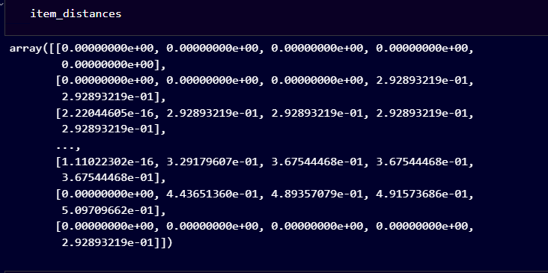
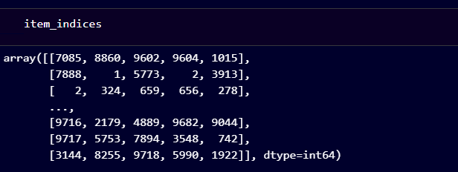
Item_distances
Item_indices

Slide 19
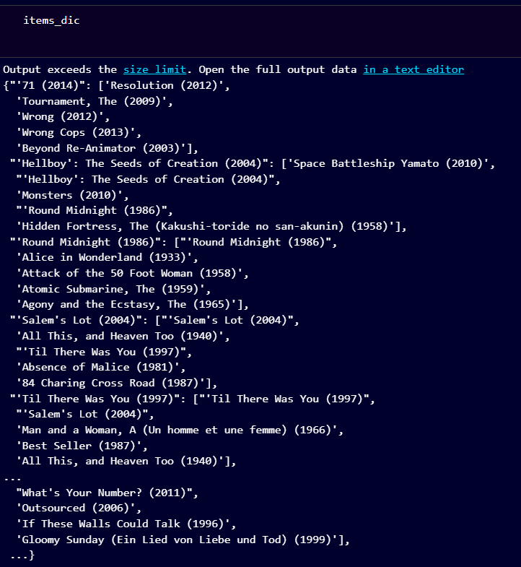

Slide 20
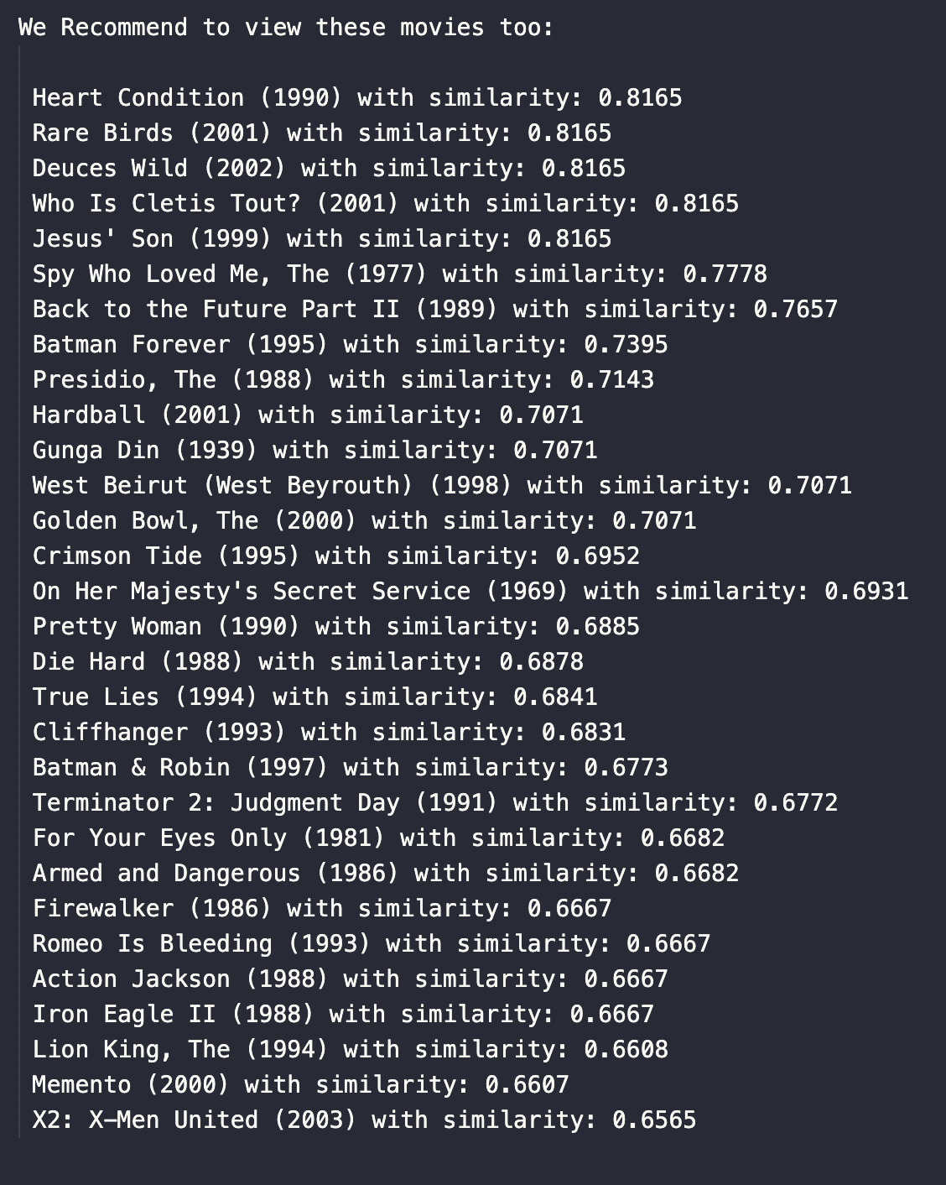
Final Output

Slide 21
Problems and their Solutions
User Cold Start: There needs to be enough other users already in the system to find a match.
Data sparsity: Not all users have rated all items. By focusing on the similarity of items rather than users, the system can provide recommendations even when data is sparse.
Popularity Bias: Cannot recommend items to someone with unique tastes. Tends to recommend popular items.
Diversity: Item-based collaborative filtering can help provide diverse recommendations that cover a wide range of user preferences.

Slide 22
WORK FLOW
Knowledge Gathering
Data Collection
Data Preprocessing
Similarity Computation
Nearest Neighbors
Rating Predictions

Slide 24
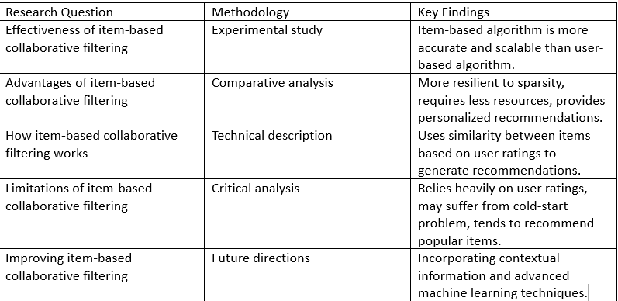
Literature Review:
"Item-Based Collaborative Filtering Recommendation Algorithms" by Sarwar et al.

Slide 25
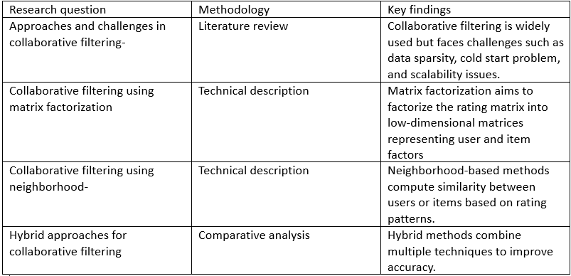
Sharma, Ritu, Dinesh Gopalani, and Yogesh Meena. "Collaborative filtering-based recommender system: Approaches and research challenges."

Slide 26
Conclusion:
In summary, Collaborative Filtering is a widely used technique in recommender systems for generating personalized recommendations by finding similar user/item pairs.
However, it faces challenges such as user and item cold-start problems, sparsity, and scalability issues. To overcome these challenges, researchers have explored combining CF with other techniques and incorporating factors such as trust, cross-domain information, context, and time-variant features.
However, there is still a lot of room for improvement and further research in this area .
We can also explore new methods to combine collaborative filtering with other approaches to resolve scalability and cold start issues. CF based approaches can be enhanced by incorporating trust, cross-domain information, context and time-variant features.

Slide 27
Bibliography
Sharma, Ritu, Dinesh Gopalani, and Yogesh Meena. "Collaborative filtering-based recommender system: Approaches and research challenges." In 2017 3rd international conference on computational intelligence & communication technology (CICT), pp. 1-6. IEEE, 2017 Vedavathi, N., and R. Suhas Bharadwaj.
"Deep Flamingo Search and Reinforcement Learning Based Recommendation System for E-Learning Platform using Social Media." Procedia Computer Science 215 (2022): 192-201. Sarwar, Badrul, George Karypis, Joseph Konstan, and John Riedl.
"Item-based collaborative filtering recommendation algorithms." In Proceedings of the 10th international conference on World Wide Web, pp. 285-295. 2001.

Slide 28

Special Thanks to Mr. Dhananjay Kumar
Karthikey Sharma
209302122
Aditya Rana
209302339

